Slide 1
Vth AIDA EUROPE CONFERENCE
COPENHAGEN
10th AIDA CCWP Meeting
INTERNATIONAL INSURANCE LAW ASSOCIATION - AIDA

Slide 2
CLIMATE CHANGE WORKING PARTY
MANDATORY WASTE MANAGEMENT IN THE INSURANCE SECTOR:
PERSPECTIVES AND LEGISLATURE SCENE
SALVAGE WASTE MANAGEMENT AS SUSTAINABILITY PRACTICE

Slide 3


AIDA/Brazil
AIDA/Brazil
MARIA DA GLORIA FARIA
Lawyer, graduated from Rio de Janeiro State University - UERJ, with a Masters Degree on Corporate Law from Cândido Mendes University with a Certification on College Didacticism, IAG Master on Insurance from PUC-RJ, Specialist on Social Security from UERJ, member of the Board of Appeals of the National System of Private Insurance – CRSNSP - period 2009/2013, Surrogate member of the Administrative Board of Fiscal Appeals - CARF since3 2010, Vice – President of the International Insurance Law Association – AIDA Brazil and Legal Superintendent at the National Confederation of Insurance, Private Life and Pension Funds, Supplementary Health and Capitalization Company (CNSeg/Fenaseg).
PERY SARAIVA NETO
PhD student of Law at/PUCRS, with a Master’s Degree in Law from UFSC and Specialist on Environmental Law from FUNJAB/UFSC. Professor (Graduation and Post-Graduation). Guest Professor at UFRGS, FGV/Rio, ESMESC, ESA/OAB, UNIDAVI, UNIVALI e UNOESC. Member of the Research Group on Environmental Law and Political Ecology in a Risk Society /UFSC. Cultural Vice-President at the International Insurance Law Association AIDA/BRAZIL. President of the National Task-Force on Environmental Insurance at AIDA/BRASIL. General-Secretary of the Insurance Law Committee at OAB/SC. Former member of the Environment Committee at OAB/SC (2008/2010). Author and Collaborator in books and articles such as Evidence in the Environmental Jurisdiction (Livraria do Advogado/2010), Legal Aspects of Insurance Contracts (Livraria do Advogado/2013), Legal Aspects of Insurance Contracts Year II (Livraria do Advogado/2014) and Legal Aspects of Insurance Contracts Year III (Livraria do Advogado/2015). Lawyer and Legal Consultant.
GLAUCE CARVALHAL
Lawyer with Degree from Rio de Janeiro Federal University - UFRJ, with Post-Graduation Degree on Constitutional Civil Law from Rio de Janeiro State University - UERJ, with Specialization on Insurance and Reinsurance Law from Fundação Getúlio Vargas, Legal Manager at the National Confederation of Insurance, Private Life and Pension Funds, Supplementary Health and Capitalization companies (CNSeg/Fenaseg).

Slide 4
BRAZILIAN SCENE
Registered Fleet with Denatran*: 81 million vehicles
Vehicles Robbery and Theft: 416 thousand vehicles in 2014
Recovered Vehicles: approx.. 50%
Obs.: 30 million vehicles with 5 or more years of use**.
* ** Traffic National Department

Slide 5
BRAZILIAN SCENE
2 million
Estimated amount of vehicles apprehended due to irregularities or tax debts to the State.

Slide 6
BRAZILIAN SCENE
Most robbed or stolen vehicles have as destination clandestine disassembling yards.

Slide 7
BRAZILIAN SCENE
1,3 million vehicles in Yards
Public Yards: DETRAN’s, Road Police, Civil Police and Military Police;
Private Yards.

Slide 8
CONSEQUENCES
Constant production of replacing and repair parts competing with those produced for the assembling of new vehicles and the subsequent deficit that adds up to the increase in waiting time at the repair shops;
Improper destination of tires, lubricants, oils, batteries, waste and scrap, all natural environment contaminants.

Slide 9
TROUBLES FOR THE INSURANCE SECTOR
  R$ 18 billion collection in class 31
  16 million of insured vehicles = 25% of the fleet
  80% of brand new vehicles are insured
  4% of vehicle’s price is the insurance average premium for brand new vehicles
  5% of vehicles with 7 or more years of use are insured
  Insurance of a vehicle with 7 years of use may cost up to 20% of its value.

Slide 10
Cost of original bumper + hood of a popular vehicle
R$ 900,00 (US$ 300)
Cost of the same parts - recycled
R$ 350,00 (US$ 117)
Actual market of recycling cooperatives
124 mapped cooperatives

Slide 11
NEW LAW for SOLID WASTE
Law # 12.305 of August 2nd, 2010, disposes of Public Policy on solid wastes.
  Not the first nor the only Brazilian Law on wastes, but it’s the one that has laid out the legal framework of the sector with the creation of an articulated system among Union, States, Municipalities, Private Initiative and Society.

Slide 12
LAW # 12.305, of AUGUST 2ND, 2010
OBJETIVES and PURPOSES
NON GENERATION
REDUCTION
REUSE
RECYCLING
TREATMENT OF SOLID WASTES AND ENVIRONMENTALLY FIT FINAL DESTINATION OF THE WASTES
REVERSE LOGISTICS

Slide 13
LAW # 12.305, of AUGUST 2ND, 2010
Implementation of the National Policy on Solid Waste, focused on:
Sustainable Production and Use;
Reduction of Environmental Impacts;
Generation of Labor, Work and Income; and
Environmental Education.

Slide 14
Concepts adopted by Law # 2.305/2010
Art. 3rd - For the effectiveness of this Law, it’s understood that:
I – Sector Agreement: an agreement by and among the public power and manufacturers, importers, distributors or businesspeople, aiming the implementation of joint responsibility through the lifespan of a product;
II – contaminated area: location where there is contamination caused by the disposal, regular or irregular, of any substances or wastes;
III – orphan contaminated area: contaminated area under the responsibility of unidentified or unidentifiable persons;
IV – product’s lifespan: phases that contain the development of the product, the gathering of raw materials, production, use and final disposal;
V – selective collection: collection of solid wastes previously organized according to their composition;
VI – social control – set of mechanisms and procedures that grant society information and participation in establishing, implementing and assessment of public policies regarding solid wastes;

Slide 15
Concepts adopted by Law # 2.305/2010
VII – environmentally proper final destination: wastes destination which includes reuse, recycling, composting, recovery and energetic use or other destinations admitted by the competent departments of Sisnama, of SNVS and of Suasa, among them final disposal under specific operations norms in order to avoid damages or risk to public health and safety and to minimize adverse environmental impacts;
VIII - environmentally proper final destination: wastes proper distribution in landfills, observing specific operations norms in order to avoid damages or risk to public health and safety and to minimize adverse environmental impacts;
IX – solid wastes generators: personal or corporate entities, public or private, which generate solid wastes through their activities, consumption included;
X – management of solid wastes: set of actions applied, direct or indirectly, to the collection, transportation, transshipment, treatment and environmentally proper final destination of the wastes, in accordance with the municipal plan for integrated management of solid wastes or with the solid wastes management plan, in accordance with this law;
XI – solid wastes integrated management: set of actions concerning the search for solutions for solid wastes, taking into consideration the political, economic, environmental, cultural and social dimensions, under social control and sustainable development;

Slide 16
Concepts adopted by Law # 2.305/2010
Art. 3rd - For the effectiveness of this Law, it’s understood that:
XII – reverse logistics : a tool for economic and social development characterized by a set of actions, procedures and means destined to make possible the collection and the return of solid wastes to the corporate sector for reuse, in its productive cycles or another final environmentally proper final destination;
Art. 33. Are forced to structure and implement systems of reverse logistics, through the returning of products after their use by consumers, regardless of the public service of urban cleaning and handling of solid wastes, manufacturers, importers, distributors and business people (...)

Slide 17
Concepts adopted by Law # 2.305/2010
XVI – solid wastes: discarded material, substance, object or good as result of human activities in society, whose final destination is, will be or is required to be carried out, in solid or semisolid state, as well as gases in recipients or liquids whose specificities make them improper to be discarded in the public swage systems or in water bodies, or that demand non-practicable technical or economical solutions according to the best available technology;

Slide 18
LAW #12.305, OF AUGUST 2ND, 2010
NATIONAL POLICY OF SOLID WASTES
OBJECTIVES
Art. 7º - Objectives of National Policy on Solid Wastes:
I – protection of public health and environment quality
II – non generation, reduction, reuse, recycling and treatment of solid wastes, as well as proper environmental final disposal of wastes;
……………………………………………………………………………………………………
VI – incentive to the recycling industry to increase the use of raw materials and inputs from recycled material;
VII – joint management of solid wastes;

Slide 19
LAW # 12.305 of 2010
NATIONAL POLICY OF SOLID WASTES
OBJECTIVES (continuation)
VIII – good relatioships within different areas of public powers, and those with the private area, aiming technical and financial cooperation for the joint management of solid wastes;
...............................................................................................................................................
XIII – incentives to the implementation of products’ lifespan assessment (important for the assessment of the renewal of vehicle fleet)

Slide 20
LAW # 12.305 of 2010
NATIONAL POLICY OF SOLID WASTES
INSTRUMENTS
Art. 8o – Are instruments of the National Policy on Solid Wastes, among others:
I - plans of solid wastes;
II – inventories and solid wastes yearly statements;
XI – National system of information on the management of solid wastes (Sinir);
XV – the National Registry of Dangerous Wastes;

Slide 21
Law # 12.305 of 2010
MANAGEMENT PLAN
REACH
Art. 20. are subject to the formulation of a solid wastes management plan:
I – generators of solid wastes set on § “e”, “f”, “g” e “k” of insert I art. 13*(generated by public services of basic sanitation, generated by industrial procedures, by health services and mining)
II – commerce shops and service providers that:
a) generate dangerous wastes;
b) generate wastes which, even if classified as non-dangerous by their nature, composition or volume, are not comparable by the municipality with home wastes;
III – civil constructing companies, under the terms and regulations established by Sisnama;
IV – responsible for terminals and other installations referred to in § I of art. 13 and under the terms and regulations of Sisnama and, if applicable, transportations companies;

Slide 22
Law # 12.305 of 2010
Chapter III
- RESPONSIBILITIES OF GENERATORS AND THE PUBLIC POWER
Art. 25. The public power, the commercial sector, and the people in general are responsible for the effectiveness of actions taken to ensure the conformity with the National Policy for Solid Wastes and the regulations and decisions set forth in this law.
.......................................................................................................................................................
Art. 27. Individuals or corporate entities referred to in art. 20 are responsible for the full implementation and operation of the Solid Wastes Management Plan approved by the competent department in accordance with art. 24.
§ 1o – The hiring of services of collection, storing transporting, transshipping, treatment or final disposal of solid wastes, or final disposal of rejects does not exempt individuals or corporate entities referred to in art. 20 from the responsibility for damages that may be caused by improper management of their respective wastes of rejects.

Slide 23
Legislature History
DISASSEMBLING
2014 – São Paulo state law # 15.276 dated January 2nd, 2014 – establishes the destination of vehicles at the end of their lifespan and other dispositions. Decree (SP) # 60.150, dated February 13th, 2014 – Regulates Law # 15.276 (…)
2014 – Federal Law # 12.977, dated May 20th, 2014 – disposes of the activity of disassembling of vehicles; amends art. 126 of law # 9.503 of September 23rd, 1997 – Brazilian Traffic Law; and other dispositions.

Slide 24
CHALENGES TO THE INSURANCE MARKET
Solid Wastes Management
  set of actions applied, direct or indirectly, in the collection, transportation, transshipment, treatment and environmentally proper final destination of the wastes, in accordance with the municipal plan for integrated management of solid wastes or with the solid wastes management plan.

Slide 25
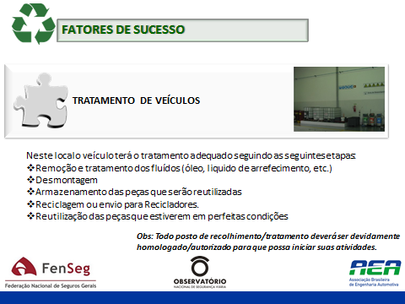
FACTORS OF SUCCESS
VEHICLE MAINTENANCE
At legal and specialized mechanic shops vehicles shall have adequate check up according to the following steps:
Removal and treatment of fluids (oil, coolant, etc.)
Disassemble
Storage of parts to be reused
Parts to be sent to recycling
Reuse of parts in perfect conditions
Obs: all collection and maintenance stations must be approved/authorized to start their activities.

Slide 26
CHALLENGES TO THE INSURANCE MARKET
LAW ENFORCEMENT
JOINT RESPONSIBILITY
SOLIDARITY IN PREVENTION, CARE AND WASTE MANAGEMENT

Slide 27
CHALLENGES TO THE INSURANCE MARKET
Management of Solid Wastes
Set of actions applied, direct or indirectly, during collection, transport, transshipment, treatment or environmental proper final disposal of solid wastes and environmental proper final disposal of rejects, in accordance with the solid wastes joint management municipal plan or with the solid wastes management plan.

Slide 28
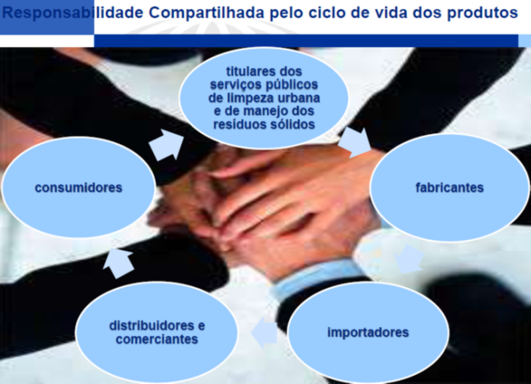
Shared Responsibility for products’ life span
holders of public services, urban cleaning and solid waste management
consumers
manufacturers
Distributors and business people
importers

Slide 29
REVERSE LOGISTICS
JOINT RESPONSIBILITY
  Set of individual and joint responsibilities of manufacturers, importers, distributors and businessmen, consumers and those in charge of urban cleaning services and transport of solid wastes, to minimize the amount of solid wastes generated, as well as to reduce impacts caused to human health and to the environment quality resulting from products’ lifespan, under the articles of this law.

Slide 30
ADVANTAGES
PUBLIC SAFETY
  Reduction in theft of vehicles
  Reduction in violence levels, specially in large urban centers
  Lowering crime by the disincentive of illicit associations

Slide 31
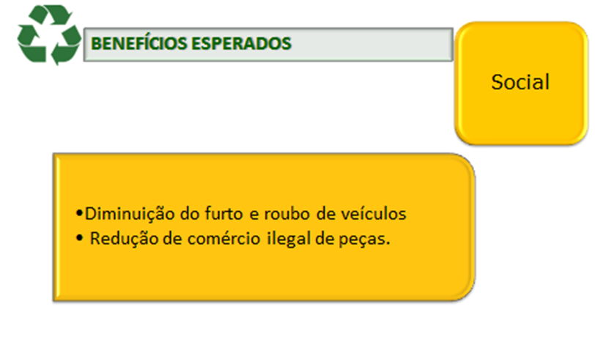
EXPECTED BENEFITS
Reduction in theft of vehicles
Reduction of commerce of illegal parts
Reduction in urban violence
Disincentive to illicit associations

Slide 32
ADVANTAGES
ENVIRONMENT
  reduction of environment pollution through proper disposal of fluids and dangerous components (batteries, lubricants, oils, glasses and others)
  Proper disposal of wastes and parts not used in the process
  Economy of raw material
  Economy of electric power
  Economy of water

Slide 33
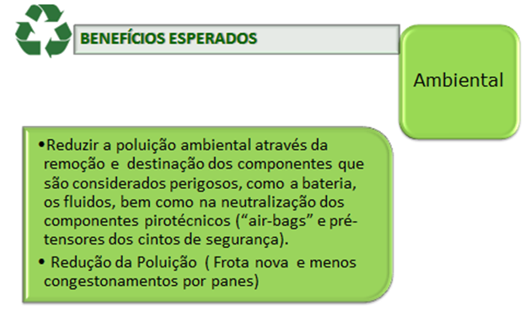
EXPECTED BENEFITS
Environment
Reduction of environmental pollution through the elimination and disposal of components considered dangerous, such as batteries, fluids, as well as the neutralization of flammable elements (air-bags and belt holders).
Reduction of the fleet (a new fleet is less affected by defects).

Slide 34
ADVANTAGES
ECONOMIC ORDER
  Supplying the market with reusable parts bearing certified origin, safety reliability and low prices
  More than 40 million car owners potential buyers
  Jobs generation at the recycling chain and other indirect chains
  Increase in tax collection due to a formal services market.

Slide 35
ADVANTAGES
HEALTH
No soil contamination close to dams, water fountains and water tables.
Less gas emission due to better vehicle maintenance and subsequent fewer respiratory allergies
Fewer vehicles in scrapyards and less concentration of standing waters resulting in fewer illnesses, specially dengue.

Slide 36
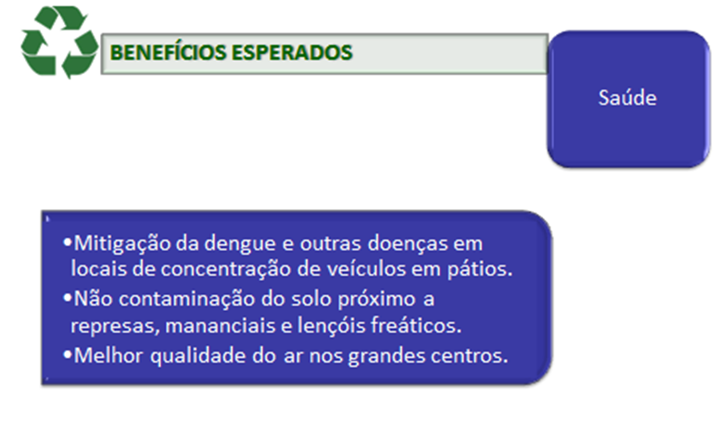
EXPECTED BENEFITS
Health
Mitigation of dengue and other illnesses at places with large concentration of vehicles in scrapyards.
No soil contamination close to dams, water fountains and water tables.
Better air quality in large centers and fewer respiratory illnesses affecting people.

Slide 37
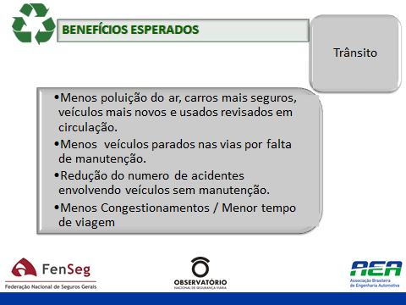
EXPECTED BENEFITS
Traffic
• Less air pollution, newer and safer automobiles and checked used cars on the streets.
• Fewer vehicles stopped on streets for lack of maintenance
• Reduction in the number of car accidents due to lack of maintenance
• Fewer traffic jams / shorter travelling time.

Slide 38


MARIA DA
GLORIA FARIA
and
GLAUCE
CARVALHAL
PERY
SARAIVA NETO
www.cnseg.org.br
juridico@cnseg.org.br
www.perysaraivaneto.com.br
contato@perysaraivaneto.com.br

Slide 39
THANK YOU!!!

